Slide 1
T.C.
KASTAMONU ÜNİVERSİTESİ
TAŞKÖPRÜ MYO
BİLGİSAYAR PROGRAMCILIĞI
Veri Tabanı ve Yönetimi
7. Bölüm
Öğr. Gör. Sevdanur GENÇ
sgenc@kastamonu.edu.tr
Kastamonu, 2020

Slide 2

AJANDA
JOİN İLE İLGİL UYGULAMALAR
  UYGULAMA 1
  UYGULAMA 2

Slide 3
UYGULAMA 1

Slide 4
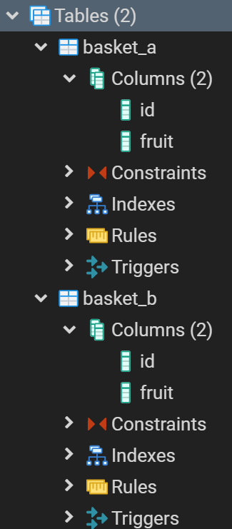
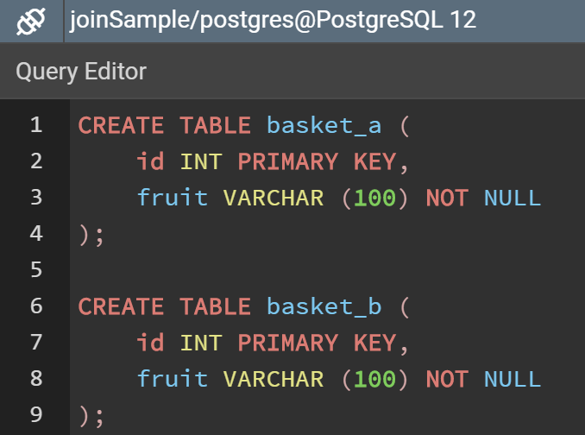
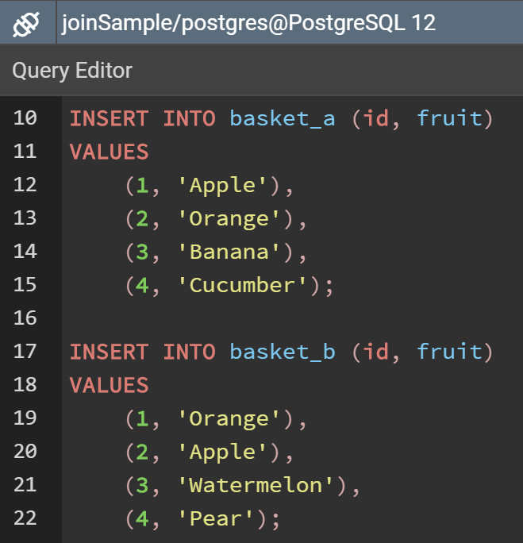
UYGULAMA 1 : ÖRNEK VT’NIN TASARLANMASI

Slide 5
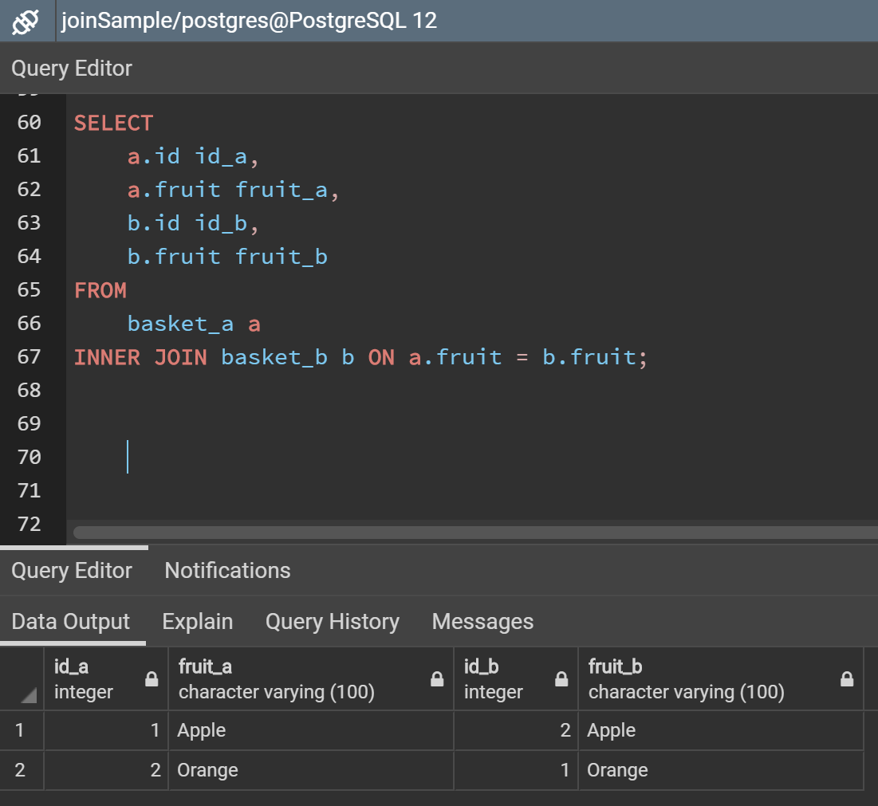
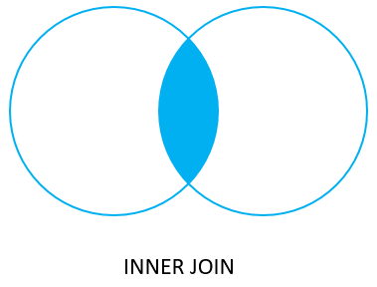
İNNER JOİN
Notes:
https://www.postgresqltutorial.com/postgresql-full-outer-join/

Slide 6
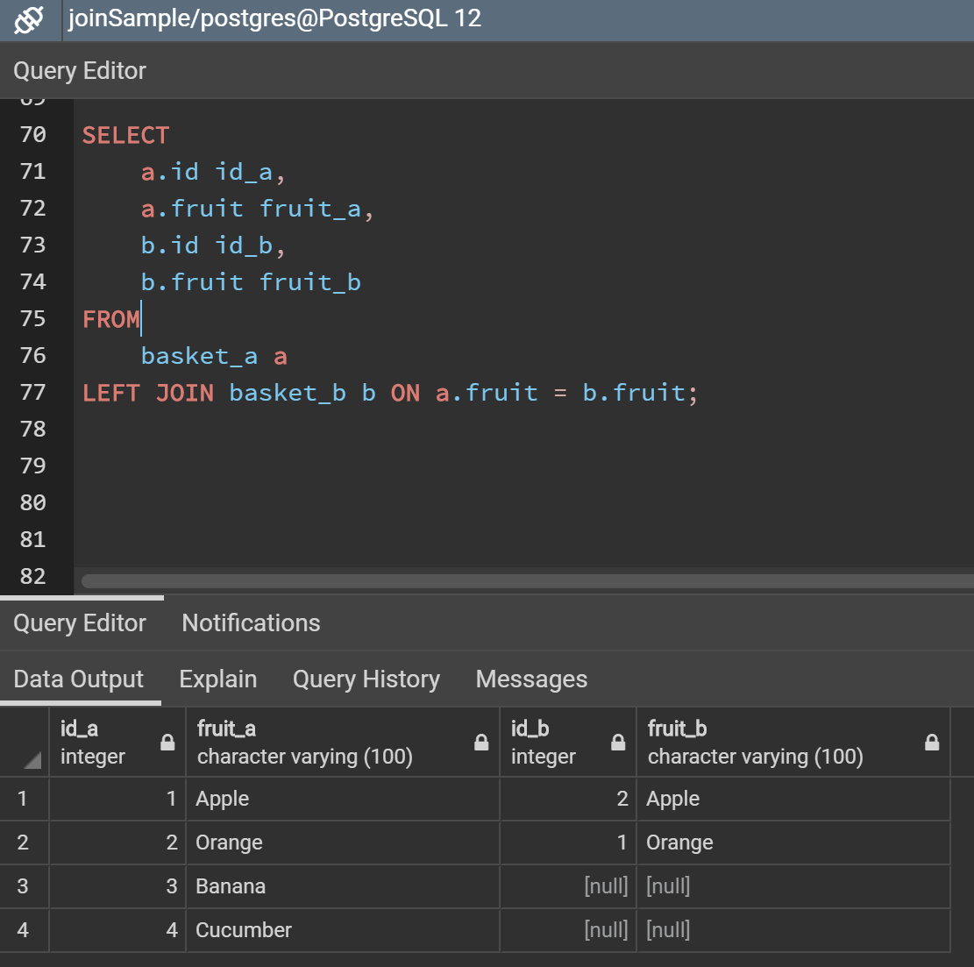
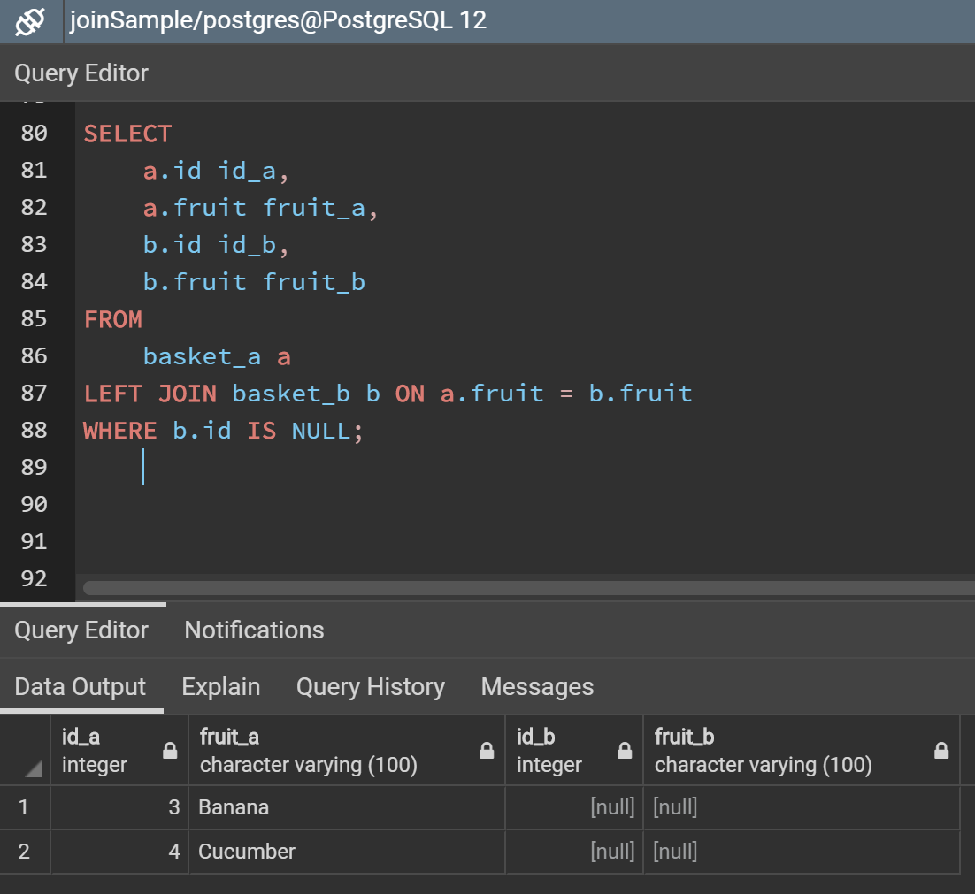

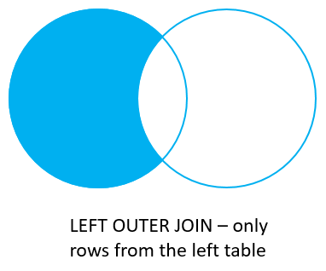
LEFT OUTER JOİN
Notes:
https://www.postgresqltutorial.com/postgresql-full-outer-join/

Slide 7
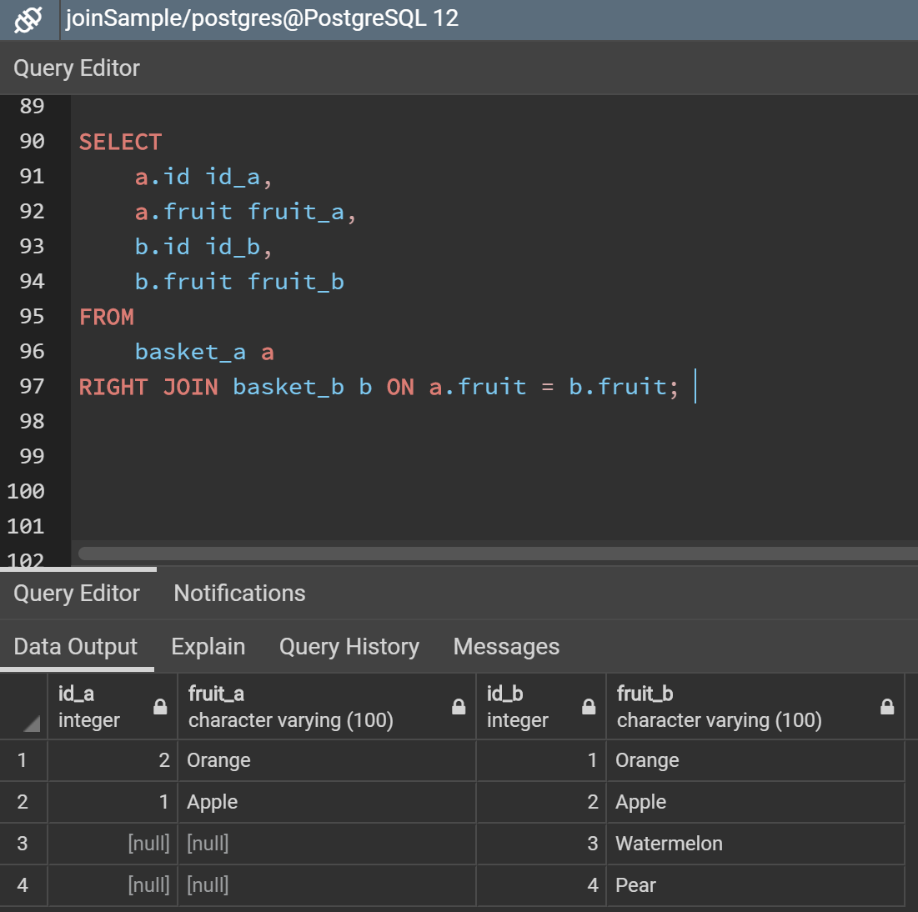
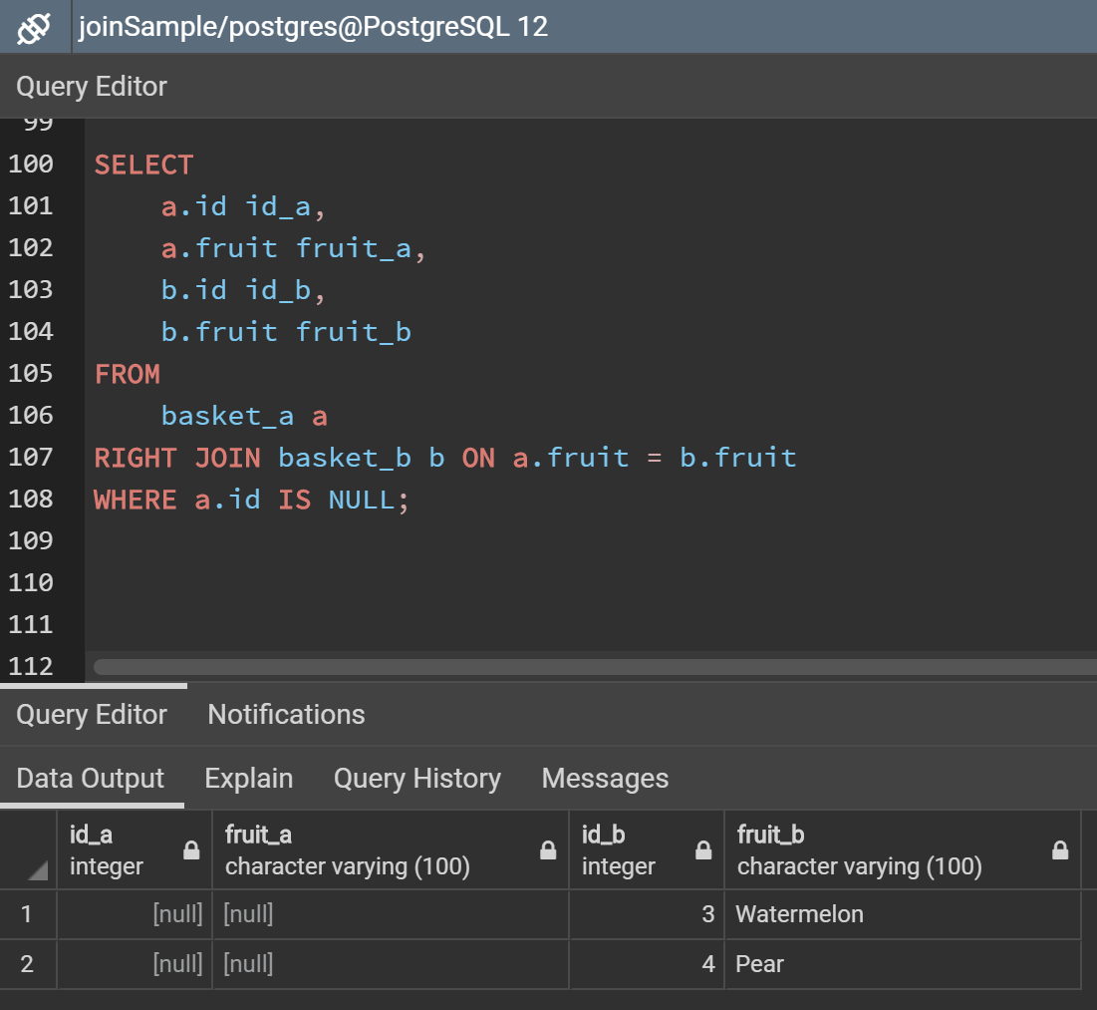

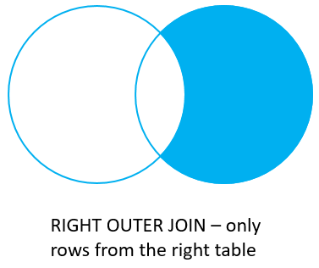
RİGHT OUTER JOİN
Notes:
https://www.postgresqltutorial.com/postgresql-full-outer-join/

Slide 8
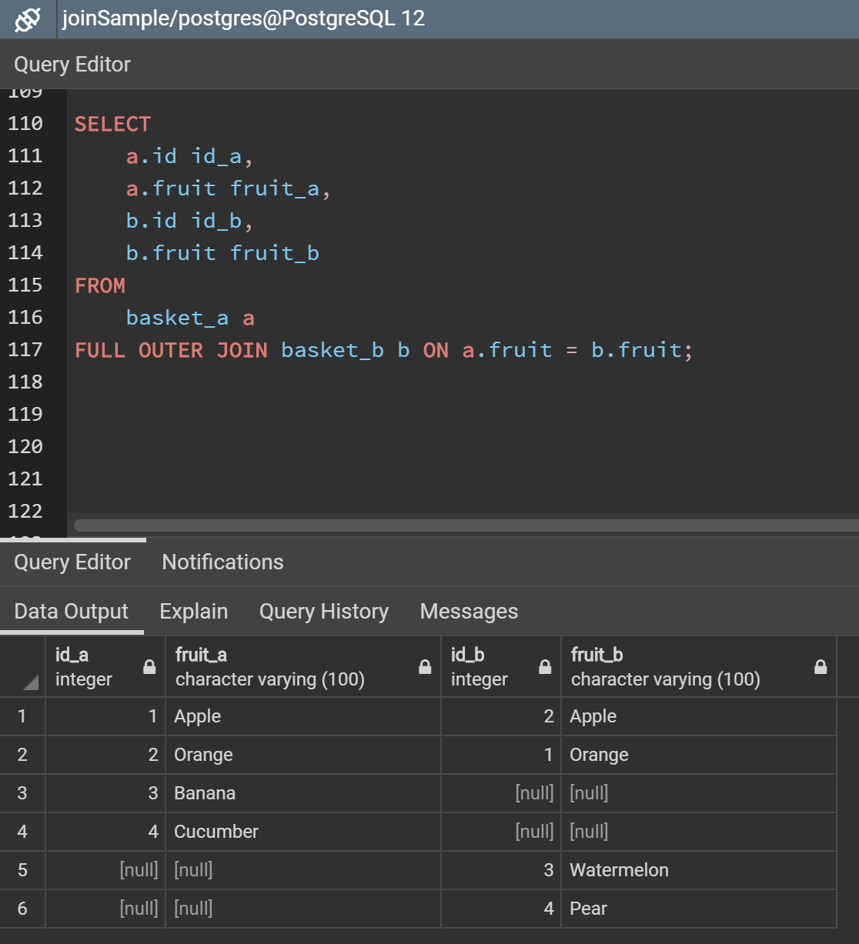
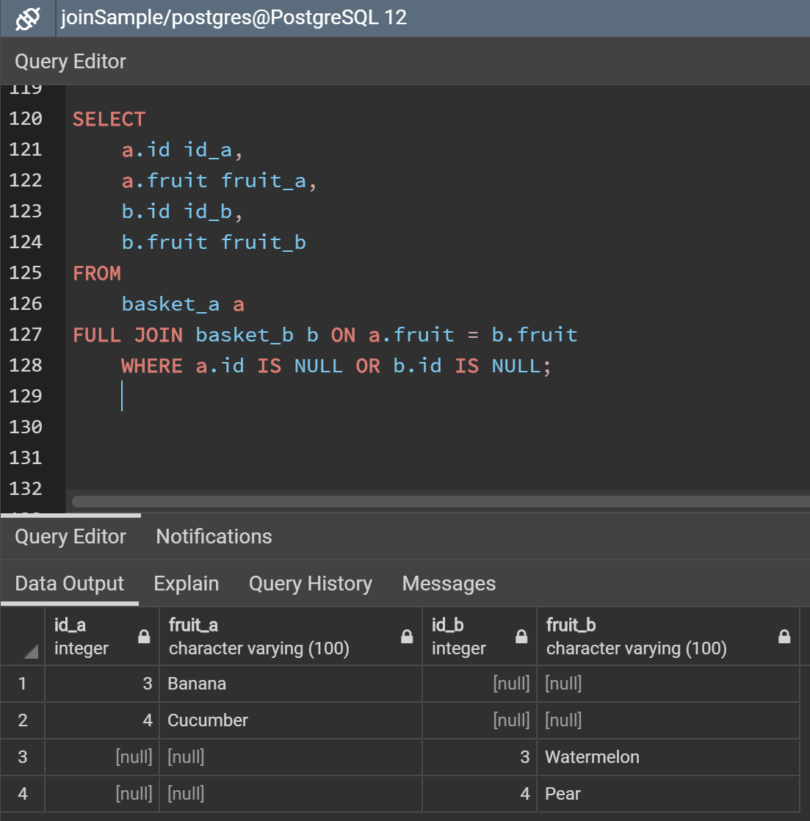

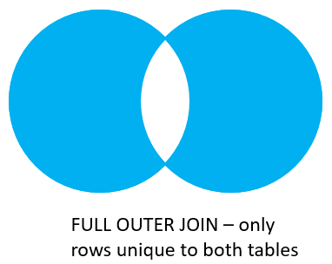
FULL OUTER JOİN
Notes:
https://www.postgresqltutorial.com/postgresql-full-outer-join/

Slide 9
UYGULAMA 2
Notes:
create table departman(
d_id serial primary key,
d_ismi varchar(255) not null
);
create table personel(
p_id serial primary key,
p_ismi varchar(255),
d_id integer
);
insert into departman(d_id, d_ismi)
values (1, 'Satis'),
(2, 'Pazarlama'),
(3, 'Insan Kaynaklari'),
(4, 'IT - Bilgi islem'),
(5, 'Uretim');
select * from departman;
insert into personel(p_id, p_ismi, d_id)
values (1, 'Bette Nicholson', 1),
(2, 'Christian Gable', 1),
(3, 'Joe Swank', 2),
(4, 'Fred Conster', 3),
(5, 'Sandra Kilmer', 4),
(6, 'Julia McQueen', null);
select * from personel;
select p.p_ismi, d.d_ismi
from personel p
inner join departman d on p.d_id = d.d_id
where p.p_id = 3
select p.p_ismi, d.d_ismi
from personel p
inner join departman d on p.d_id = d.d_id
order by d.d_ismi
select p.p_ismi, d.d_ismi
from personel p
left join departman d on d.d_id = p.d_id
where d.d_ismi is null
select p.p_ismi, d.d_ismi
from personel p
right join departman d on d.d_id = p.d_id
where p.p_ismi is null
select p.p_ismi, d.d_ismi
from personel p
full outer join departman d on d.d_id = p.d_id
--where p.p_ismi is null
where d.d_ismi is null
create table demirbas(
dm_id serial primary key,
dm_ismi varchar(255),
d_id integer
);
insert into demirbas(dm_id, dm_ismi, d_id)
values (1, 'Mantar Pano', 1),
(2, 'Bilgisayar', 4),
(3, 'Yazici', 4),
(4, 'Mouse', 4),
(5, 'Fatura Kocani', 2);
select * from demirbas;
select p.p_ismi, d.d_ismi, dm.dm_ismi
from personel p
inner join departman d on p.d_id = d.d_id
inner join demirbas dm on dm.d_id = d.d_id
select p.p_ismi, d.d_ismi, dm.dm_ismi
from personel p
left join departman d on p.d_id = d.d_id
left join demirbas dm on dm.d_id = d.d_id
select p.p_ismi, d.d_ismi, dm.dm_ismi
from personel p
right join departman d on p.d_id = d.d_id
right join demirbas dm on dm.d_id = d.d_id
select p.p_ismi, d.d_ismi, dm.dm_ismi
from personel p
full join departman d on p.d_id = d.d_id
full join demirbas dm on dm.d_id = d.d_id

Slide 10
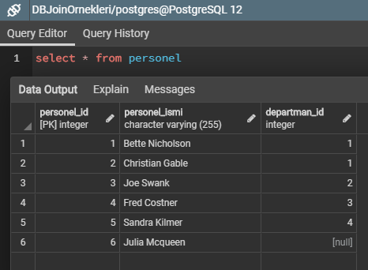
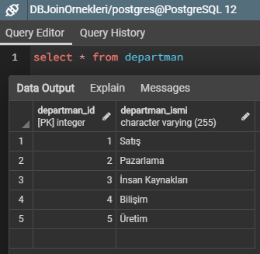
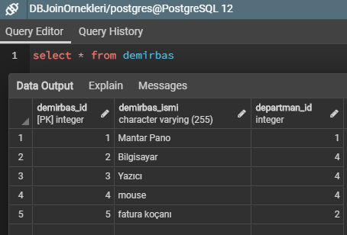
UYGULAMA 2 : ÖRNEK VT’NIN TASARLANMASI

Slide 11
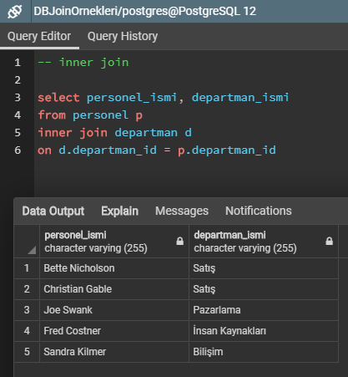
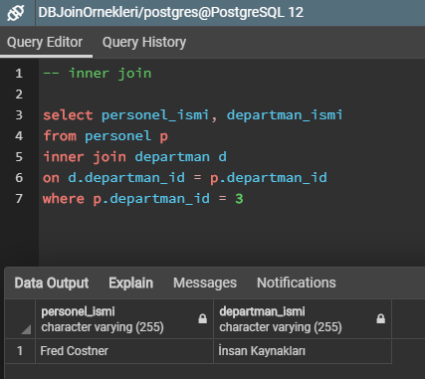
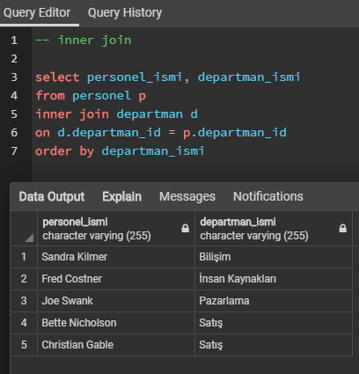
İNNER JOİN

Slide 12
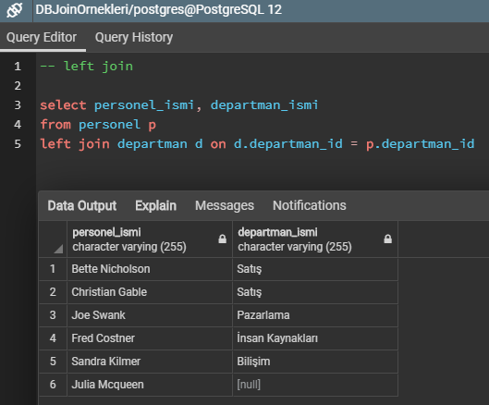
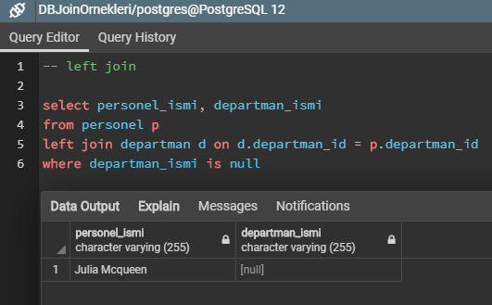
LEFT JOİN

Slide 13
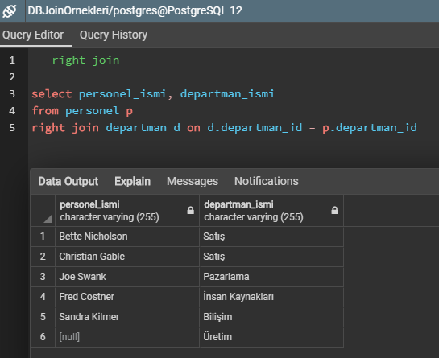
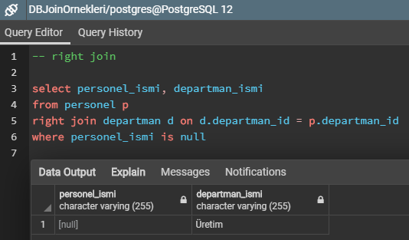
RİGHT JOİN

Slide 14
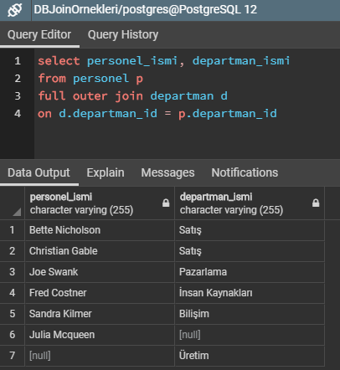
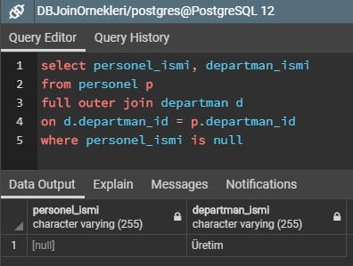
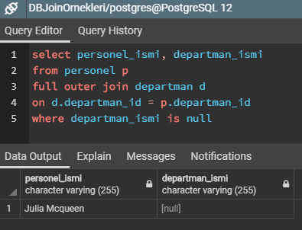
FULL JOİN
Notes:
https://www.postgresqltutorial.com/postgresql-full-outer-join/

Slide 15
KEYİFLİ ÇALIŞMALAR...

